Slide 1


Topic
Routing Protocols (RIP, OSPF, BGP)

Slide 2
Introduction
Packets may pass through several networks on their way to destination
Each network carries a price tag, or a “metric”
The metric of a network may be:
constant (i.e. each network costs one hop)
Service type-dependent (the cost of the network depends on what service the packet needs: e.g. throughput, delay, .. etc.)
Policy-dependent: a policy defines what paths should, or should not, be followed.
The router uses a “routing table” to determine the path
Static vs. Dynamic routing tables.

Slide 3
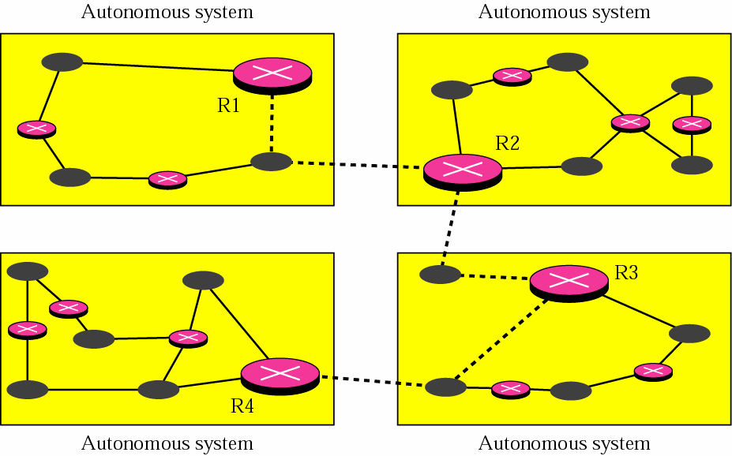
Interior & Exterior Routing
Autonomous system: a group of networks and routers under authority of a single administrator

Slide 4
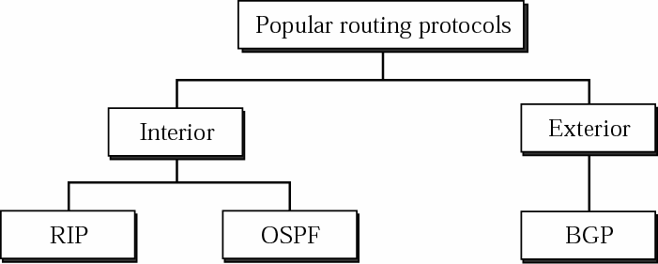
Popular Routing Protocols
Figure 16.02

Slide 5
Routing Information Protocol (RIP)

Slide 6
RIP: Routing Information Protocol
Distance Vector Routing
Share the most you know about the entire autonomous system
Share with all your direct neighbors, and them only
Share periodically, e.g. every 30 seconds
Destination | Hop Count | Next Hop | Other Info
163.5.0.0 | 7 | 172.6.23.4
197.5.13.0 | 5 | 176.3.6.17
189.45.0.0 | 4 | 200.5.1.6

Slide 7
RIP Updating Algorithm
Receive: a response RIP message
Add one to the hop count for each advertised destination
Repeat for each advertised destination
If ( destination is not in my routing table)
Add the destination to my table
Else If ( next-hop field is the same)
Replace existing entry with the new advertised one
Else if (advertised hop-count –after incrementing- is smaller)
Replace existing entry with the new advertised one

Slide 8


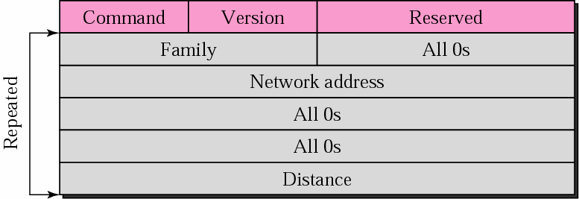

RIP Message Format
1: Request
2: Response
Address Family Identifier
2: TCP/IP family
1 or 2
12 Bytes
Hops from advertising router to dest. network

Slide 9
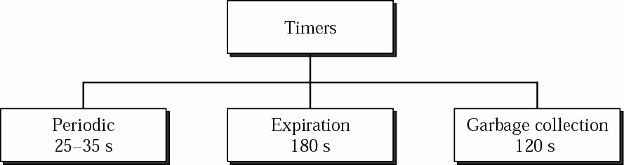
RIP Timers
Figure 16.09
Periodic Timer ( 25 < random < 35): controls advertising of update messages. There ONE such timer
Expiration Timers: governs route validity. Reset upon receipt of an update. If it ever expires, destination is considered unreachable.
Q-Yet, entry is not removed from table, it continues to be advertised with hop count
= 16 ( i.e. infinity)
Garbage Collection Timers: Reset to 120sec when a route is invalidated. If it expires, the route entry is completely removed from routing table

Slide 10

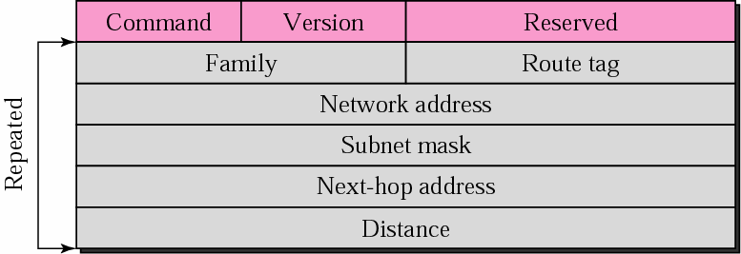


RIP-v2 Format: Same length as in RIP-v1
AS
number
RIP version 2 supports CIDR.
RIP messages are encapsulated in a UDP datagram
RIP uses the services of UDP on well-known port 520.
or prefix
useful if 2 AS share a backbone network

Slide 11
Distance Vector Routing & Path Vector Routing

Slide 12
Introduction
Distance vector and link state routing are both interior routing protocols.
They can be used inside an autonomous system. Both of these routing protocols become intractable when the domain of operation becomes large.
Distance vector routing is subject to instability if there is more than a few hops in the domain of operation.
Link state routing needs a huge amount of resources to calculate routing tables.
It also creates heavy traffic because of flooding.
There is a need for a third routing protocol which we call path vector routing.

Slide 13
Inter VS Intra
The difference between the distance vector routing and path vector routing can be compared to the difference between a national map and an international map.
A national map can tell us the road to each city and the distance to be traveled if we choose a particular route; an international map can tell us which cities exist in each country and which countries should be passed before reaching that city.

Slide 14
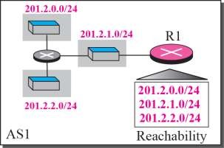
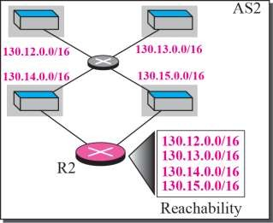


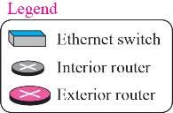
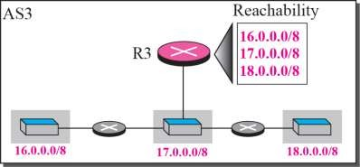
Reachability
Figure 16.16

Slide 15
Border Gateway Protocol (BGP)
Border Gateway Protocol (BGP) is an interdomain routing protocol using path vector routing.
Border Gateway Protocol version 4, BGP-4, is the standard for inter-AS routing
one or more routers in each AS use BGP to communicate with other such routers in other Autonomous Systems
BGP is loosely based on distance-vector
however, instead of telling each other "I can reach network X in D hops",
BGP speakers in different Autonomous Systems list the Autonomous Systems they would cross to reach a given destination

Slide 16
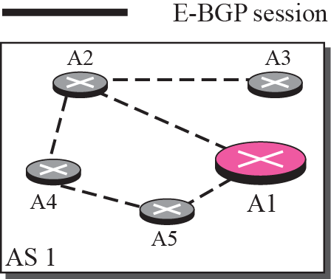
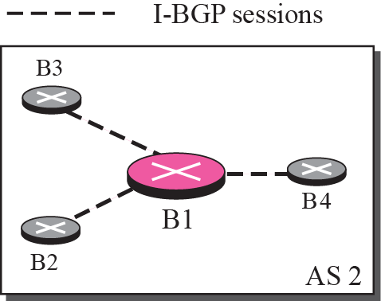
Internal and external BGP sessions
Figure 16.19
A speaker node advertises the path, not the metric of the nodes, in its AS or other ASs.

Slide 17
Path Vector Routing (1)
Sharing
A speaker in an AS shares its table with immediate neighbors
Updating
Adding the nodes that are not in its routing table and adding its own AS and the AS that sent the table
The routing table shows the path completely

Slide 18
Path Vector Routing (2)
Loop prevention
A route checks to see if its AS is in the path list to the destination
Policy routing
If one of the ASs listed in the path is against its policy, it can ignore that path and that destination
It does not update its routing table with the path, and it does not send this message to its neighbors

Slide 19
Types of AS
Stub AS
Only one connection to another AS (only a source or sink for data traffic)
Multihomed AS
More than one connection to other AS, but it is still only a source or sink for data traffic
Transit AS
Multihomed AS that also allows transient traffic

Slide 20
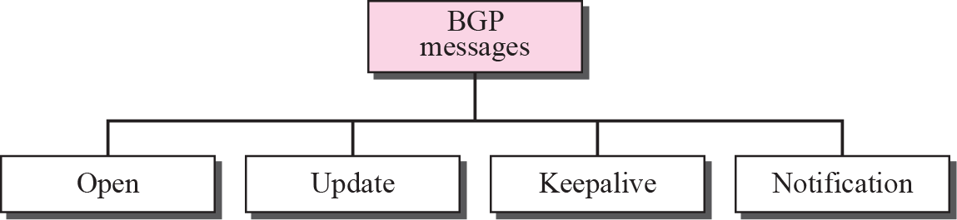
Types of BGP messages

Slide 21
Open Shortest Path First (OSPF)

Slide 22
Introduction
The Open Shortest Path First (OSPF) protocol is an intra-domain routing protocol Its domain is also an autonomous system.
OSPF packets are encapsulated in IP datagrams.

Slide 23
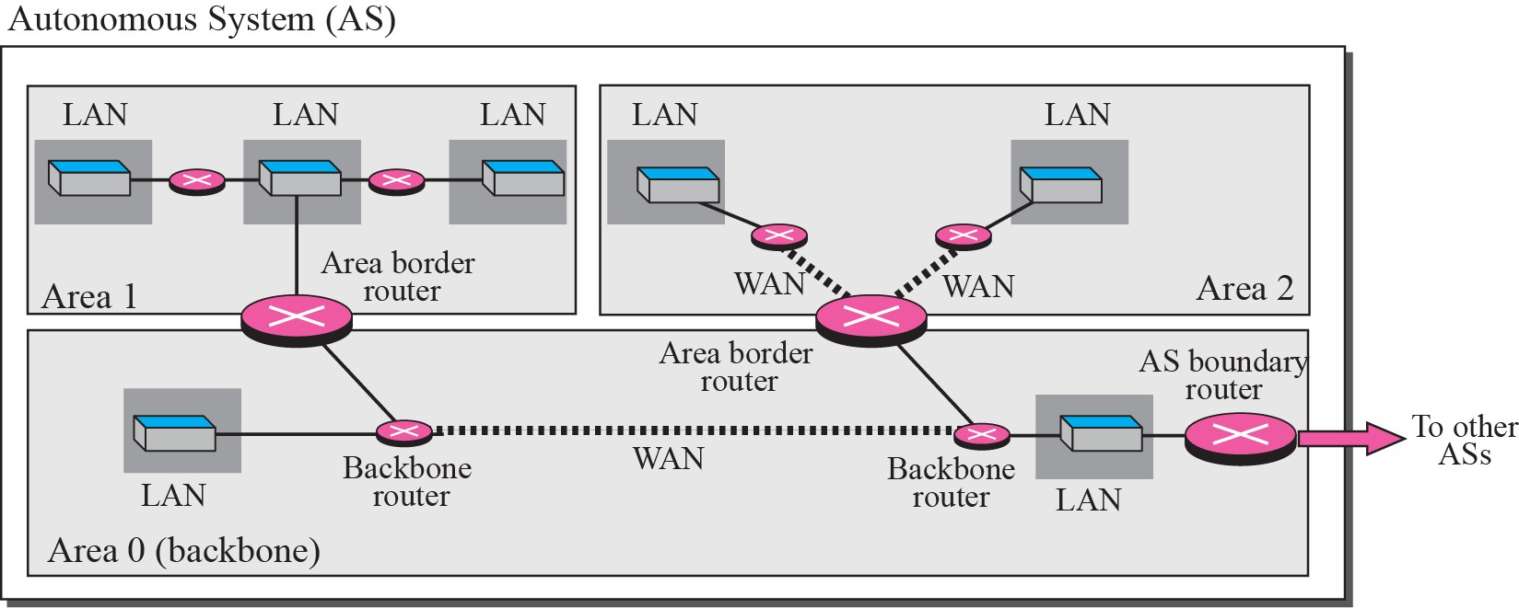
Areas in an autonomous system

Slide 24
Area in OSPF (1)
A collection of networks with area ID
Routers inside an area flood the area with routing information
Area border routers summarize the information about the area and send it to other areas
Backbone area and backbone routers
– All of the area inside an AS must be connected to the backbone

Slide 25
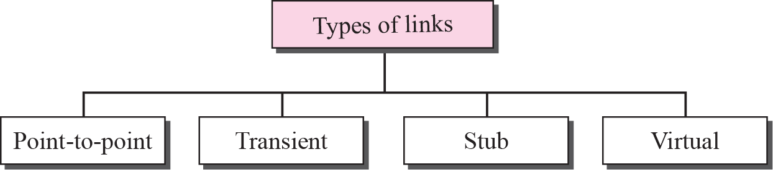
Types of Links
Figure 16.27

Slide 26
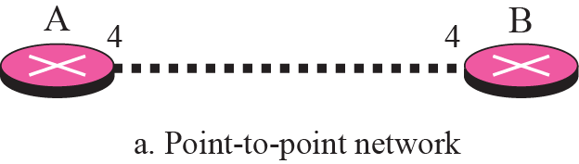
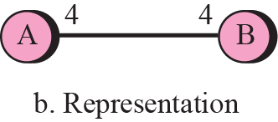
Point-to-point link
Figure 16.28

Slide 27
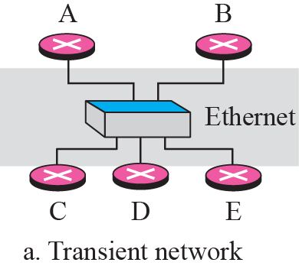
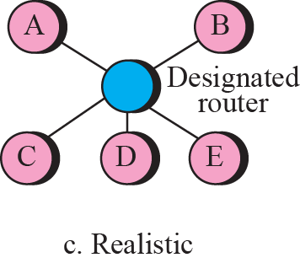
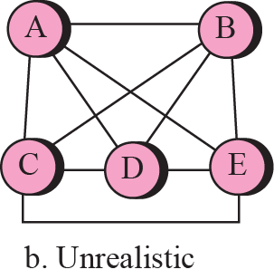
Transient Link
Figure 16.29

Slide 28
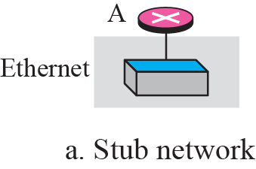
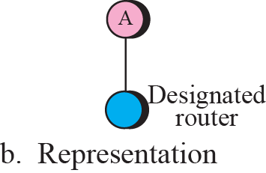
Stub link
Figure 16.30

Slide 29
Internet Control Message Protocol (ICMP)
The Internet Control Message Protocol (ICMP) is a network layer protocol used by network devices to diagnose network communication issues.
ICMP is mainly used to determine whether or not data is reaching its intended destination in a timely manner.
Commonly, the ICMP protocol is used on network devices, such as routers.
ICMP is crucial for error reporting and testing, but it can also be used in distributed denial-of-service (DDoS) attacks.

Slide 30
How does ICMP work?
This makes ICMP a connectionless protocol: one device does not need to open a connection with another device before sending an ICMP message.
Normal IP traffic is sent using TCP, which means any two devices that exchange data will first carry out a TCP handshake to ensure both devices are ready to receive data.
ICMP does not open a connection in this way.
The ICMP protocol also does not allow for targeting a specific port on a device.

Slide 31
DHCP
Dynamic Host Configuration Protocol (DHCP) is a network management protocol used to automate the process of configuring devices on IP networks, thus allowing them to use network services such as DNS, NTP, and any communication protocol based on UDP or TCP
A DHCP server dynamically assigns an IP address and other network configuration parameters to each device on a network so they can communicate with other IP networks.

